Slide 1
K
SCHOOL PITCH DECK
Run the school.
Lift the learning.
Klas
Manager
One beautiful workspace for academics, people, fees, boarding, access and parent communication.
The operating system for a
calmer, more connected school.
What changes on Monday morning?
Everyone sees the next right action — without chasing spreadsheets.
A practical walkthrough for school leaders
KLAS MANAGER · School operations, made clearer
01

Slide 2
THE CASE FOR CHANGE
Schools do not need more software. They need less friction.
Klas Manager connects the work that already happens across departments.
01
02
03
One source of truth
Fewer handoffs
Better family experience
Student, staff, class and finance records stay connected.
Teachers, bursars and administrators work from the same live context.
Parents can see progress, fees and school updates in one branded portal.
The outcome: a school that feels coordinated to staff, visible to leaders, and reassuring to parents.
KLAS MANAGER · School operations, made clearer
02

Slide 3
THE PLATFORM
One workspace, arranged around the school day.
01
02
03
People
Academics
Finance
Students, guardians, staff and role-based access
Classes, subjects, attendance, results and reports
Fee structures, bills, offline collections and audit trail
04
05
06
Boarding & care
Access & safety
Family experience
Houses, pastoral notes, health and welfare
Gate passes, visits, security verification and attendance
Parent portal, updates, receipts and progress
KLAS MANAGER · School operations, made clearer
03

Slide 4
FOR THE SCHOOL ADMINISTRATOR
Start with a clean student record — then let the rest of the system follow.
A student record becomes the
spine of the school.
A single student can answer:
•
Where is the student assigned?
Class or boarding house
•
What does the family owe?
Fees, bills and receipts
Class · guardian · health · boarding · fees
results · attendance · access history
•
Who may collect them?
Approved gate access
•
How are they doing?
Results, attendance and notes
KLAS MANAGER · School operations, made clearer
04

Slide 5
FOR TEACHERS
A focused academic workspace — not an admin maze.
Teachers see the modules their role allows, with the daily work close at hand.
Today
Role-based by design
08:00
Take attendance
A teacher can work confidently
without seeing finance or owner tools.
09:40
Mark classwork
12:10
Review weak topics
Permissions shape the workspace, not the other way around.
15:30
Publish a result
KLAS MANAGER · School operations, made clearer
05

Slide 6
FOR THE BURSAR & ACCOUNTANT
Fees become a record, not a reconciliation exercise.
The manual collection flow
Klas tracks the full picture
1
Find the student
• Offline collections
• Klas service charge
• School-only bills
• Immutable audit trail
2
Choose the fee or bill
3
Enter amount + method
4
Save receipt + ledger
Every payment has a who, when, why and where.
KLAS MANAGER · School operations, made clearer
06

Slide 7
FOR PARENTS
A portal that answers the questions families ask most.
?
How is my child doing?
?
What do I owe?
Progress, results and attendance
Fee structures, bills and discounts
?
What happened at school?
?
Can I trust the handover?
Branded announcements and updates
Gate passes and visit controls
Built to feel like a familiar day-to-day app — on phone, tablet or desktop.
KLAS MANAGER · School operations, made clearer
07

Slide 8
BOARDING, HEALTH & SAFETY
Pastoral care becomes visible without becoming noisy.
Boarding
Health
Access
Houses · rooming · welfare
check-ins · pastoral notes
Medical unit · allergies
incidents · emergency context
Gate passes · visit days
security verification
The same student context follows the child from classroom to gate.
KLAS MANAGER · School operations, made clearer
08

Slide 9
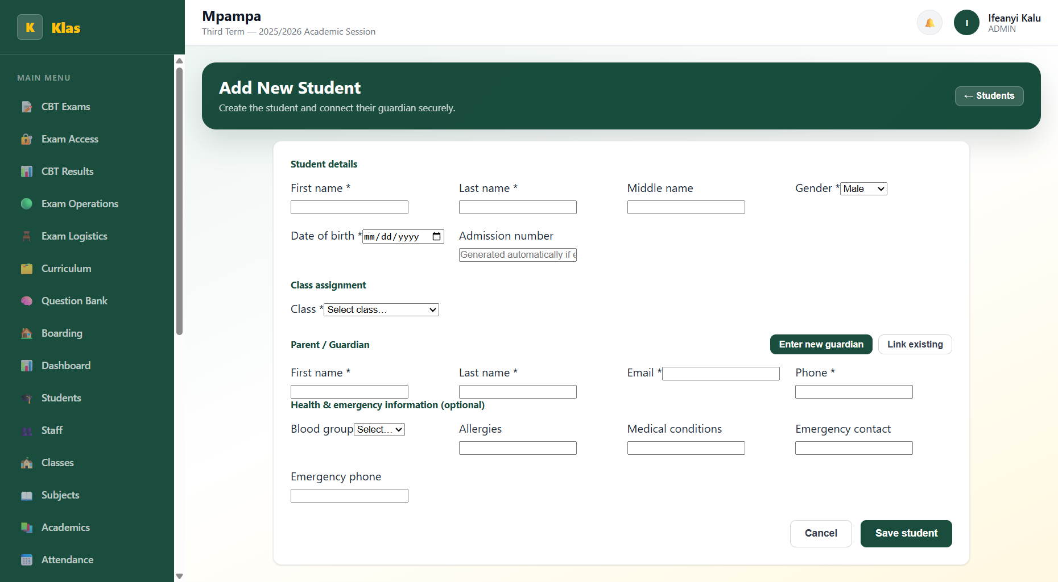
WHAT THE EXPERIENCE FEELS LIKE
A calm, branded interface for real school work.
Designed for confidence
Clear sections.
Consistent actions.
No mysterious dead ends.
The visual system can be branded per school while Klas keeps the workflows consistent.
KLAS MANAGER · School operations, made clearer
09

Slide 10
THE LEARNING MOAT
A question library that gets smarter with every school.
Klas Exam Engine
Curriculum → subject → topic → question → explanation
01
02
03
04
Source
→
Review
→
Practice
→
Mastery
Licensed packs + school uploads
Teachers flag, approve and improve
Randomized, timed, adaptive exams
Weak-topic recommendations for learners
For schools: build your own. For Klas: grow a trusted global library.
KLAS MANAGER · School operations, made clearer
10

Slide 11
A SIMPLE ROLLOUT
Schools can start small and expand without re-platforming.
Week 1
Week 2
Month 2
Always
Set up
Go live
Deepen
Improve
School profile, classes, staff and students
Attendance, fees, parent access and reports
Boarding, gate access, health and messaging
Exam engine, insights and automation
The implementation promise: useful on day one, richer every term.
KLAS MANAGER · School operations, made clearer
11

Slide 12
A better school day
is the product.
K
Klas Manager gives every role a clear place to work — and every family a clearer view of school life.
Klas
Manager
One workspace.
Many better days.
Book a school walkthrough
klasmanager.com
KLAS MANAGER · School operations, made clearer
12

